Slide 1
EDA IN TIME SERIES ANALYSIS AND PORTFOLIO OPTIMIZATION
Group No :2
Moitryee Majumdar -12307350
Pavani Shinde -12303298
Lakshmi Priya Posana -12314144

Slide 2
Introduction of time series
In our project, we incorporated time series analysis to enhance our understanding of stock performance over time. Time series analysis involves examining data points collected or recorded at specific intervals, allowing us to identify trends, patterns, and seasonal variations in stock prices.
By analyzing historical stock data from companies like Infosys, Sun Pharma, and Tata Motors, we can observe how their prices have fluctuated over days, months, or years.
Integrating time series analysis into our project empowers us to create a more comprehensive investment strategy, ultimately aiding in maximizing returns while minimizing risks.

Slide 3
data gathering
In this phase, we collected essential data from various reliable sources to analyze stock performance effectively. The data was sourced from:
Infosys Official Website: We gathered financial reports and stock performance metrics to understand the company's growth trajectory.
Sun Pharma Official Website: Data on earnings, market trends, and product launches was collected to assess the pharmaceutical sector's dynamics.
Tata Motors Official Website: We retrieved information on sales figures, production data, and market strategies to evaluate the automotive industry's performance.
National Stock Exchange (NSE): We accessed real-time stock prices, historical data, and trading volumes to inform our investment strategies.
Yahoo Finance: This platform provided additional insights, including analyst ratings, news updates, and comprehensive financial summaries.
By gathering data from these reputable sources, we ensured a robust foundation for our analysis and investment strategy development.

Slide 4
Exploratory Data Analysis
In our project, we explored how stocks have performed over time using charts and graphs. This helped us figure out the best ways to invest your money. Our goal was to find the right mix of stocks to boost your earnings while keeping risks low.
To achieve this, we used two powerful strategies: the Efficient Frontier and Robust Optimization. These methods help us create the ideal investment plan.
For example, if you have Rs. 10,000 to invest, our model will suggest how to divide that money among different stocks. This way, you can aim for higher returns while minimizing risk. By using the Efficient Frontier and Robust Optimization, we can optimize your investment portfolio for the best possible results!

Slide 5
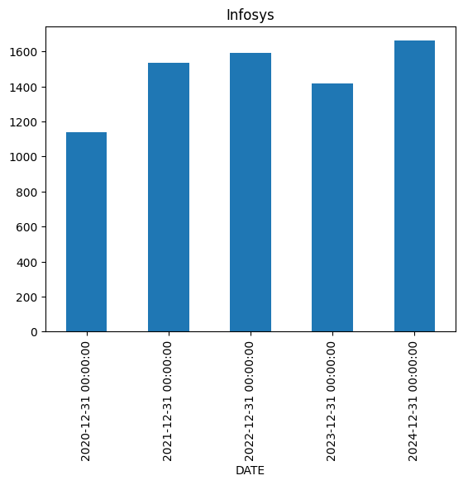
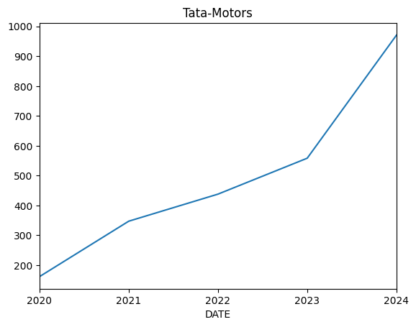
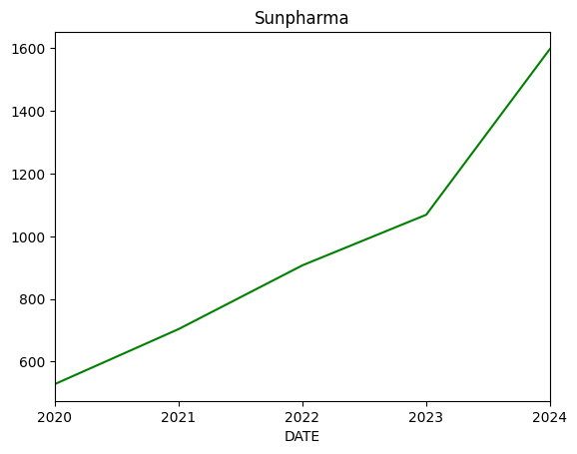
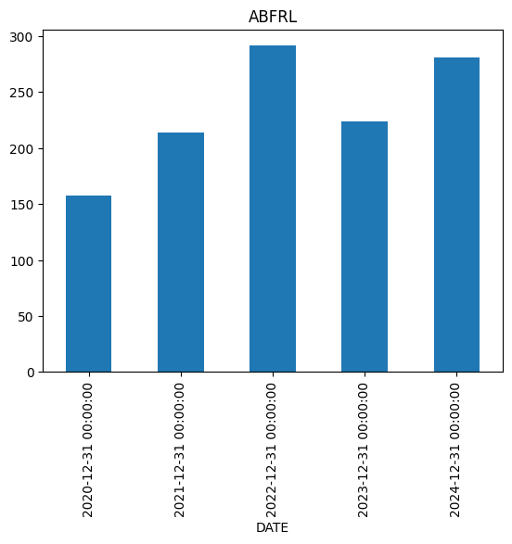
Time series analysis with respect to year

Slide 6
Standard Deviation
In our analysis, we utilized standard deviation to measure the volatility of stock prices for each company in our portfolio: Infosys, Sun Pharma, Tata Motors, ABFRL, and Bajaj Finance. Standard deviation provides insights into how much a stock's price fluctuates over time compared to its average price.
By comparing the standard deviations of each stock, we can assess their risk profiles. Stocks with higher standard deviations are generally considered riskier, while those with lower standard deviations are seen as more stable investments.
standard deviation is a crucial metric in our portfolio optimization process, guiding us in selecting the right mix of stocks to maximize returns while managing risk effectively.

Slide 7
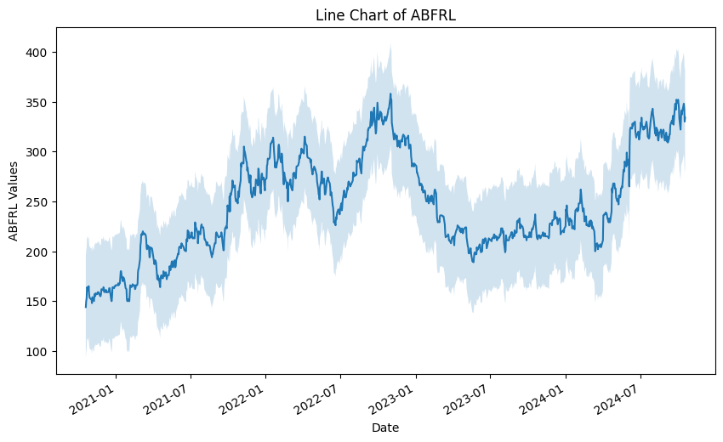
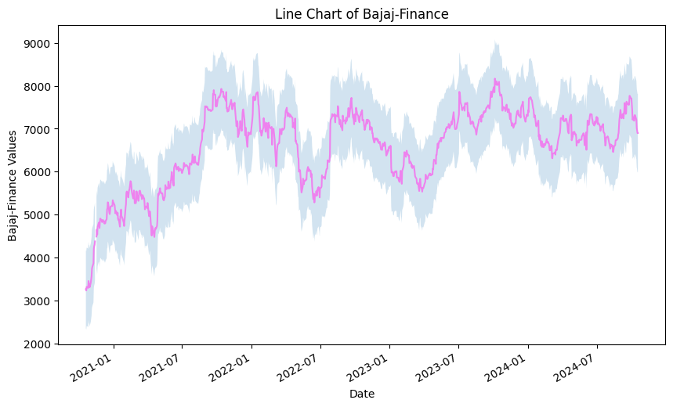


Slide 8
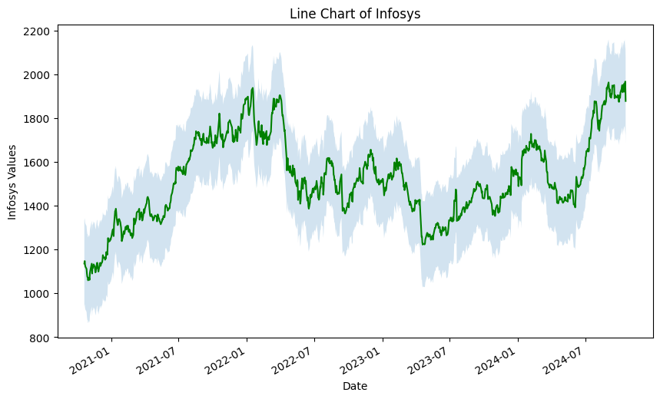
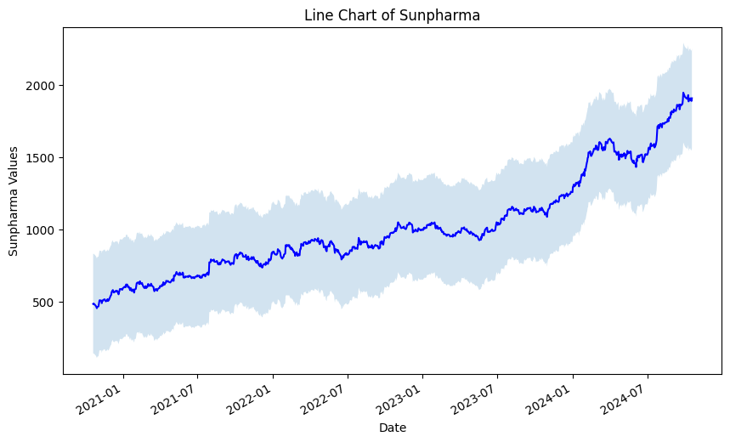
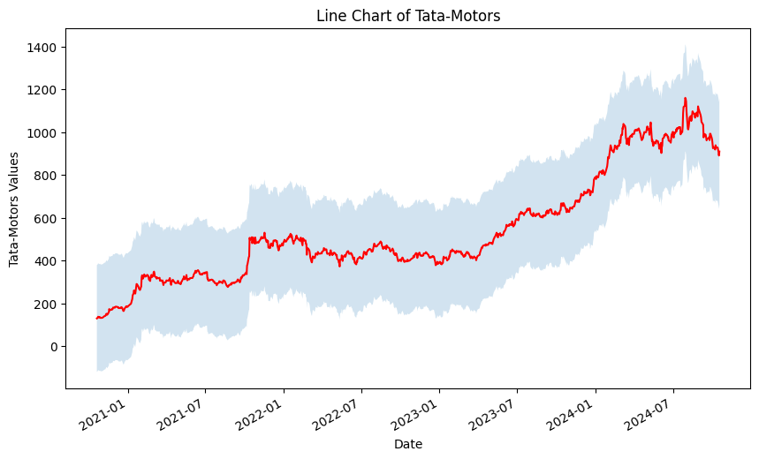

Slide 9
BETa
Beta measures a stock's volatility in relation to market movements. It helps investors assess how sensitive their portfolios are to market changes, guiding investment decisions.
The formula for beta is derived from the covariance of the stock's returns with the market's returns, divided by the variance of the market's returns.
Formula: β=Cov(ri,rm)Var(rm)/Var(rm​)Cov(ri​,rm​)​
Understanding beta is crucial for effective portfolio diversification and risk management. It aids investors in making informed decisions based on market sensitivity, ultimately enhancing investment strategies.
beta =1 exactly as volatile as the market, beta >1 more volatile than the market
beta <1 less volatile than the market
beta <0 negatively correlated to the market
beta =0 uncorrelated to the market

Slide 10
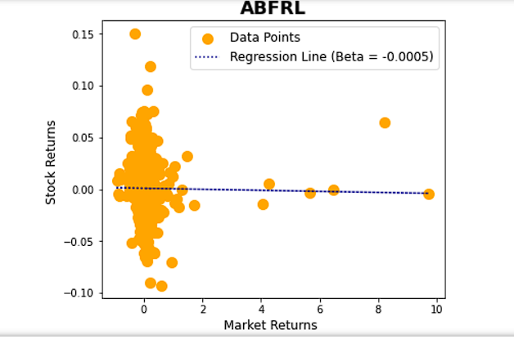
This graph shows a regression line with a beta value of -0.0005, indicating a very weak negative linear relationship between the variables. The scattered data points further confirm the lack of a strong correlation, suggesting that the independent variable has negligible practical impact on the dependent variable. Overall, the data does not demonstrate a meaningful linear association between the analyzed variables.

Slide 11
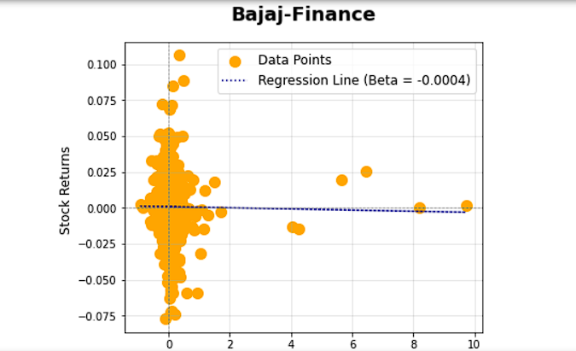
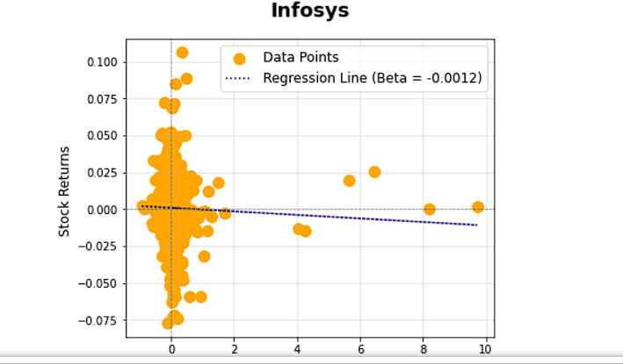
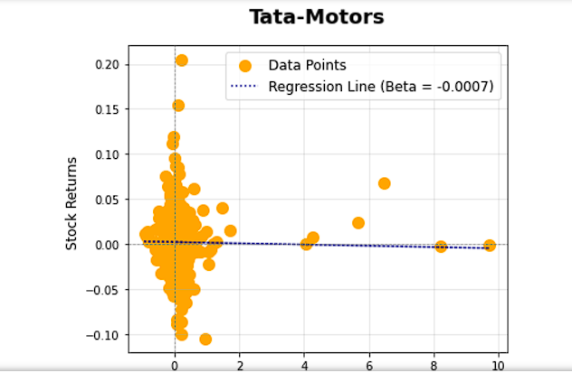
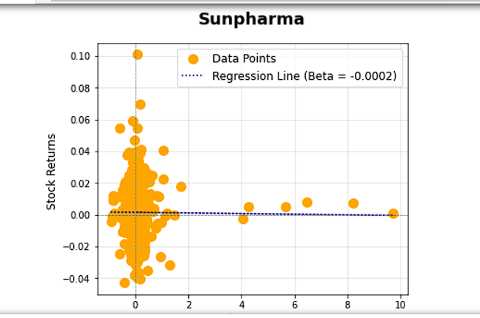

Slide 12
Efficient frontier
This concept is from finance for portfolio optimization. It will suggest the most optimal resource allocation percentage for each stock in the portfolio so that expected annual return will be higher with no or small change in risk factor.
Expected annual return | 32% | 49%
Annual volatility/risk | 20% | 21%
Resource allocation | 20%,20%,20%,20%,20% | 66%,33%,1%

Slide 13
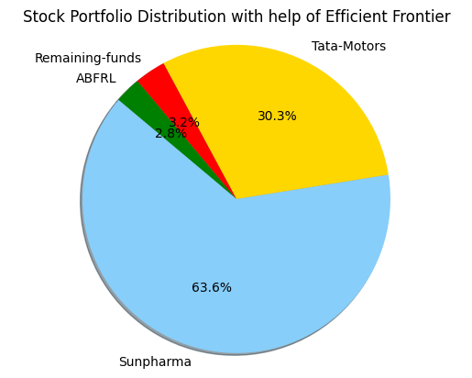

Slide 14
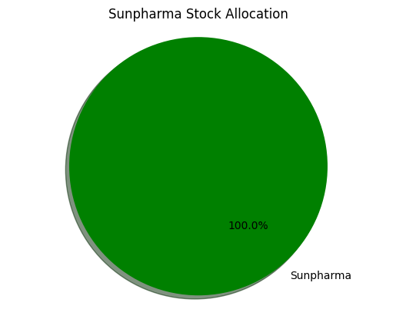
Robust Optimization
This method considers all the future uncertainty for optimizing the weights / resource allocation percentage. It used returns and covariance for optimization. It uses minimum expected return , maximum expected return , covariance matrix.
It will give higher return and minimizing the risk.

Slide 15
Conclusion
Analysed historical performance of 5 stocks using line chart and standard deviation.
Calculated beta to access sensitivity to market movements.
Optimized portfolio using efficient frontier and robust optimization.
Efficient Frontier suggested balanced portfolio, while Robust Optimization favoured Sun Pharma for higher potential returns.

